Slide 1
Modelling in Cross-Disciplinary Authentic Student Research Projects
André Heck
AMSTEL Institute
University of Amsterdam
www.science.uva.nl/~heck

Slide 2
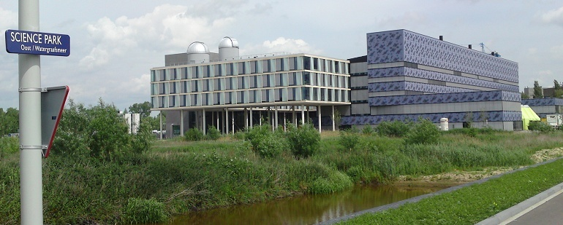
Contents
Background AMSTEL, my work
Bungee jumping project Niek Dubbelaar & Remco Brantjes (2003)
Gait analysis Caroline van Dongen (2007)
Chaotic systems Freshmen at the Faculty of Science
Conclusions
References

Slide 3
1. Background
AMSTEL Institute’s mission
improve education in the MST subjects in general for all levels of education;
explore the possibilities of ICT and new media in MST education and take care of the implementation.
Higher education
Master in Mathematics and Science Education;
communication & education stream of science masters;
training of academic skills of students
didactic training and support of science staff;
curriculum innovation projects;
diagnosis and support of the transition from secondary to higher education;
outreach.

Slide 4
Secondary education
Research and development on:
curriculum in mathematics, science, and technology;
inquiry-based learning;
ICT in MST-education;
design and development of Coach a versatile, activity-based, learning and multimedia authoring environment for mathematics, science, and technology.
My personal interests:
ICT-supported practical investigations by pre-university students (16-18 yrs);
mathematical perspectives on an integrated computer learning environment

Slide 5
2. Bungee jumping
An example of a high school student project:
in grade 11/12, students (17-18 yrs) have to do an own investigation/project, 80 hours;
come up with own idea within study profile;
gather information;
pose the research question;
design the experiment;
carry out the experiment;
compare results with literature;
report.

Slide 6
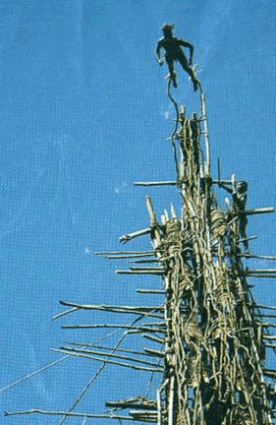
Price winners in 2003: Niek Dubelaar en Remco Brantjes
they found an article (Menz, The Physics Teacher, 1993) on the Internet talking about acceleration greater than g during bungee jumping;
their report.

Slide 7
What did they do? -1
their starting point in fact was a >g during the phase in which the jumper is ‘catapulted’ by the bungee;
their research question dealt with the phase before the bungee get stretched, and in fact is of much more interest …

Slide 8
What did they do? -2
they did use video measurement, but experienced that this is not that straightforward;
they found a new article (Kagan & Kott, The Physics Teacher, 1996), made contact with David Kagan, and learned that the effect will be more dramatic in case the bungee is relatively heavy compared to the jumper: new experiments.

Slide 9
What did they do? -3
they claimed reasonable results up to a =3.9g (ratio m_{bungee}/M_{jumper}=3.5) in this second experiment;
they gave the theory/explanation, based on an article of Kagan & Kott (The Physics Teacher, 1996);
they won second price in a competition of University of Amsterdam;
they wrote an article in the NTvN: the journal of the Dutch Physical Society, October 2003.

Slide 10
Reactions. -1
Next issue: just an editors remark;
‘many reactions, next issue etc’
December 2003 issue, an overview by the editor of the reactions;
a number of physicists doubted the quality of present education in physics at secondary schools …. (no names given by the editor)
editorial comment: “The students who wrote the paper may consider it a compliment that skepticism overcame professional physicists and teachers. That’s how (or maybe just the point that) experienced intuition can be wrong.”

Slide 11
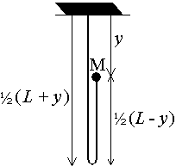
Reactions. -2
several took the contribution serious and tried to give as elegant as possible explanations (names given);
Biezeveld (physics teacher) referred to his article inThe Physics Teacher (April, 2003). He reported about a measure- ment of position with Coach, and a model calculation based on Kagan & Kott’s formula for the phase when the cord is still slack:
where

Slide 12
Reaction Hewitt to Biezeveld
Biezeveld received a reaction from Paul Hewitt: I did a Figuring Physics on it two January's ago. Not having the space to give a convincing explanation as your article supplies, I was booed by many. A website among teachers cried "Hewitt blew it!"

Slide 13
Reactions. - 3
two theoretical physicists, Pasveer and De Muynck:
Our interpretation is Galilean, so
either we start to doubt the results,
or we start to look for another force.
Both approaches not acceptable,
better focus on the system of
jumper + moving part of bungee,
and only take F_{gravitation} into account

Slide 14
Newton’s 2nd Law. -1
we are used to , so an acceleration a needs a force F as a cause
but correct is ; , and for a time dependent mass:
Because and follows a >g
the effect is caused purely by diminishing mass

Slide 15
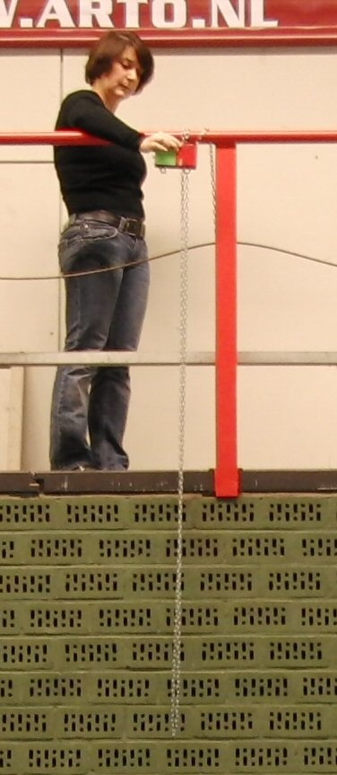
Newton’s 2nd Law. -2
M = mass of cube video of experiment m = mass of chain μ = m/M L = chain length g = acceleration of gravity a = acceleration of cube object = cube + moving part of the chain
m_{obj} = M + m (L-y )/2L
m'_{obj} = dm_{obj} /dt = -m v /2L
v_{obj} = v/2
g = a + m'_{obj} /m_{obj} ⋅ v_{obj} a = g + ½ μv ² / (μ(L-y )+2L )

Slide 16
Video analysis and computer modelling
Video analysis in Coach
Graphical system dynamics based computer model ignoring aerodynamic effects

Slide 17
Computer algebra support?
Equation 1:
implies .
Hence:
Equation 2:
Combining equation 1 and 2 gives an ODE in
solvable by hand and through a CAS.

Slide 18
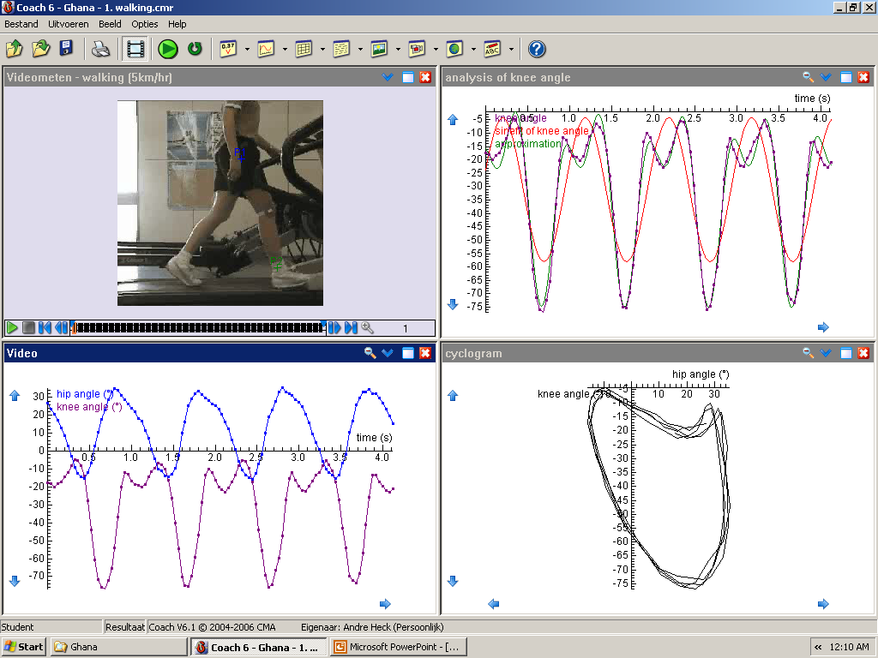
2. Gait analysis
Research project of Caroline van Dongen
Paper in Physics Education, May 2008
Research report
EMG measurement

Slide 19
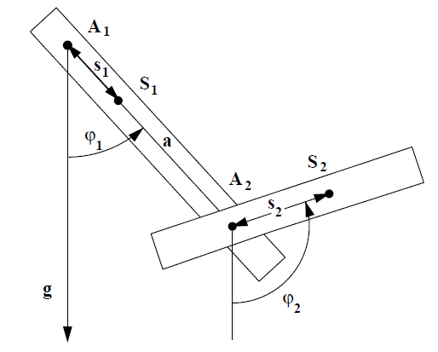
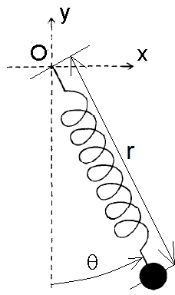
3. Chaotic systems
Double bar pendulum
example of Euler-Lagrange formalism;
computations by a CAS:
numerical integration of equations of motion;
graphical display of solutions;
exploration by students.
Spring pendulum
application of Newton’s laws;
student project in Mathematica lab connected to the Calculus 1 course in the 1st semester.

Slide 20
Double bar pendulum
Analysis of some videos showing chaotic motion
Video analysis-1
Video analysis-1a
Video analysis-1b
Video analysis-1c
Video analysis-2a
Video analysis-2b

Slide 21
Precise analytical expressions needed!
Lagrangian:
Dissipation function
Equations of motion

Slide 22
Spring pendulum
Mathematica project of 1st year student in Calculus 1 (3 lab sessions of 2 hours);
often used as example of Euler-Lagrance formalism; Lagrangian: Equations of motion:

Slide 23
Spring pendulum
Euler-Lagrance formalism in spherical coordinates Lagrangian: Equations of motion:
students only have basic knowledge of calculus and Newtonian mechanics;
Mathematica is used to explore the transition between order and chaos. Example of student work

Slide 24
Conclusions
ICT enables and facilitates authentic, relevant and quality projects for student in secondary and higher education.
Students recognize these possibilities immediately and based on experience/preparation in previous lessons largely choose them for their projects.

Slide 25
References -1
www.cma.science.uva.nl
www.science.uva.nl/~heck
Menz (1993). The physics of bungee jumping. The Physics Teacher, 31(8), 483-487.
Kagan & Kott (1996). The greater-than-g acceleration of a bungee jumper. The Physics Teacher, 34(9), 368-373.
Dubbelaar & Brantjes (2003). De valversnelling bij bungee-jumping [gravitational acceleration in bungee jumping]. Nederlands Tijdschrift voor Natuurkunde, 69(10), 316-318.
Biezeveld (2003). The bungee jumber: a comparison of predicted and measured values. The Physics Teacher, 41(4), 238-241.
Ohlhoff & Richter (2006). Forces in the double pendulum. Zeit-schrift für Angewandte Mathematik und Mechanik, 80(8), 517-534.
Van der Weele & de Kleine (1996). The order-chaos-order sequence in the spring pendulum. Physica A, 228 (1-4), 245-272.

Slide 26
References -2
Heck & van Gastel (2006). Mathematics on the Threshold. International Journal of Mathematical Education in Science and Technology, Vol. 37, No. 8, 15 December 2006, 925-945.
Heck & van Dongen (2008). Gait analysis by high school students. Physics Education, 43(3), 284-290
Heck, Kedzierska & Ellermeijer (2009). Design and implementation of an integrated computer working environment for doing mathematics and science. Journal of Computers in Mathematics and Science Teaching, 28(2), 147-161.
Heck & Ellermeijer (2009). Giving students the run of sprinting models. American Journal of Physics (accepted) .

